Slide 1
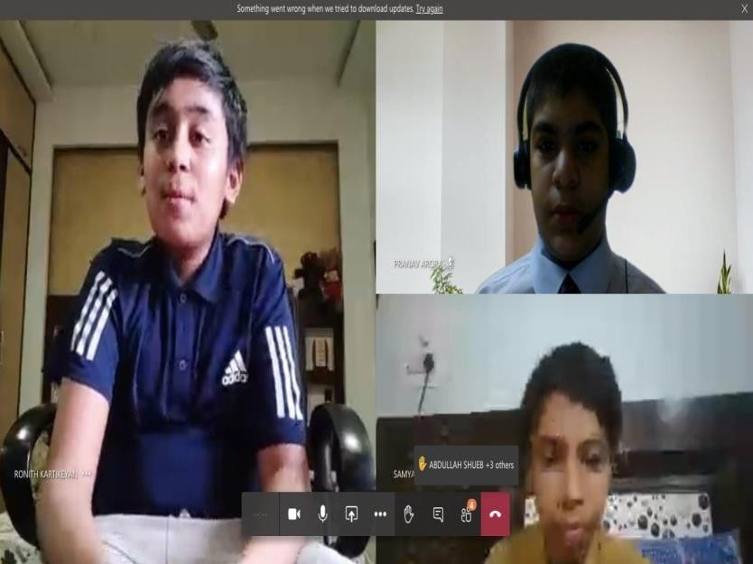
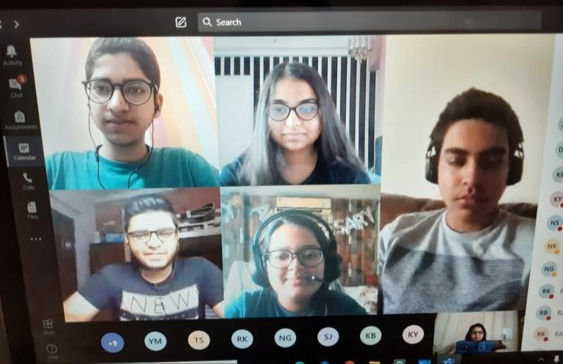
NATIONAL EDUCATION POLICY -2020
HOLISTIC PROGRESS CARD

Slide 2
NEW ACADEMIC STRUCTURE
Structure based on 21st century skills and socio- emotional developmental stages.
Curricular framework and classroom pedagogy to be based on this structure –
5+3+3+4 design
Collaborative, innovative, critical thinking, problem solving, decision making will be coupled with digital literacy and information technology, which will help in developing enquiry and competency based learning to be integrated in the report card through holistic assessment.

Slide 3
ASPECTS OF A HOLISTIC REPORT CARD
EQUITABLE
INCLUSIVE
JOYFUL
HOLISTIC
DIVERSE KNOWLEDGE
 |  |  | TRANSFORMATIVE COMPETENCIES LEARNER PROFILE( MEET THE CHALLENGES OF 21ST CENTURY WELL BEING AND SUSTAINBILITY SHAPE A BETTER FUTURE CREATING NEW VALUES RECONCILING TENSIONS TAKING RESPONSIBILITY
 |  | ATTITUDES/VALUES PRINCIPLES , BELIEF CHOICES TOWARDS INDIVIDUALS SOCIETAL ENVIRONMENTAL WELL BEING
 | SKILLS/ COMPETENCIES COGNITIVE METACOGNITIVE SOCIAL &EMOTIONAL PRACTICAL PHYSICAL
KNOWELDEGE INTERDISCIPLI NARY DISCIPLINARY EPISTEMIC PROCEDURAL

Slide 4
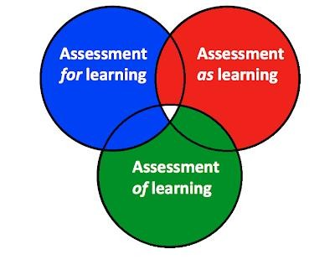
TRANSFORMING ASSESSMENT
All students will take school examinations in Grades 3, 5, and 8 also, which will test achievement of basic learning outcomes, and application of knowledge in real-life situations.
Focus on learning outcomes indicators for parents to measure and compare learning
across school.
The Board exams for Grades 10 and 12 will be continued. More emphasis on concept and application based questions.
A National Assessment Centre, PARAKH (Performance Assessment, Review, and Analysis of Knowledge for Holistic Development) to be set up as a standard-setting body for setting norms, standards, and guidelines for student assessment and evaluation for all recognized school boards.
Cont.

Slide 5
Establishing National Educational Technology Forum(NETF). Learn at their own pace
The progress card will be holistic and will include : self assessment, peer assessment ,
teacher assessment.
Boards may over time also develop further viable models of Board Exams such as - annual/semester/modular Board Exams;
Board exams will be made ‘easier’, as they will test primarily core capacities/competencies
rather than months of coaching/memorization
Assessment & accreditation of private school

Slide 6
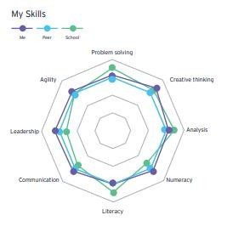
NEP IS NOT ABOUT REFORMING BUT TRANSFORMING
SELF ASSESSMENT
PEER ASSESSMENT
TEACHER ASSESSMENT

Slide 7
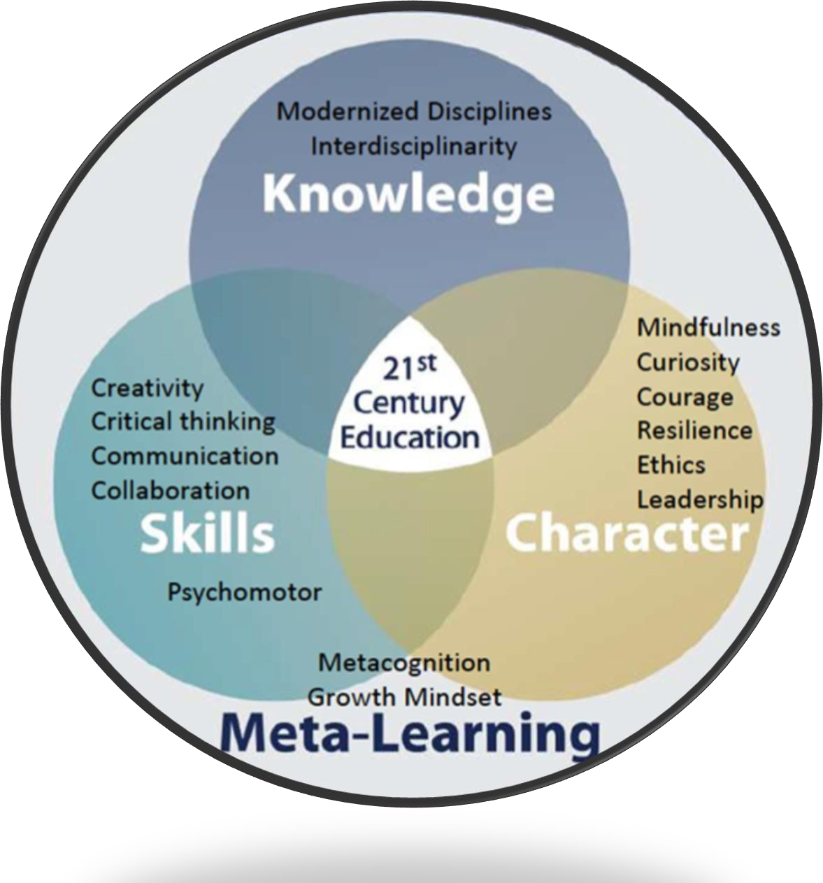
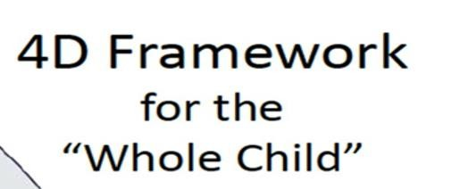

Slide 8
New Curricular Structure
Foundational Stage (in two parts, that is, 3 years of pre-school (PRE NURSERY, NURSERY & PREP)
+ 2 years in primary school in Grades 1-2; both together covering ages 3-8:
flexible, multilevel, play/activity-based learning and the curriculum and pedagogy of ECCE.
Preparatory Stage (Grades 3-5, covering ages 8-11):
introduction to Experiential learning across the sciences, mathematics, arts, social sciences, and humanities.
Middle Stage (Grades 6-8, covering ages 11-14):
with a subject-oriented pedagogical and curricular style.
Secondary Stage (Grades 9-12 in two phases, i.e., 9 and 10 in the first
second, covering ages 14-18)
and 11 and 12 in the
greater depth, critical thinking, greater attention to life aspirations, flexibility and student choice of subjects, and option to exit at grade 10 and re-enter at a later stage in std. 11.

Slide 9
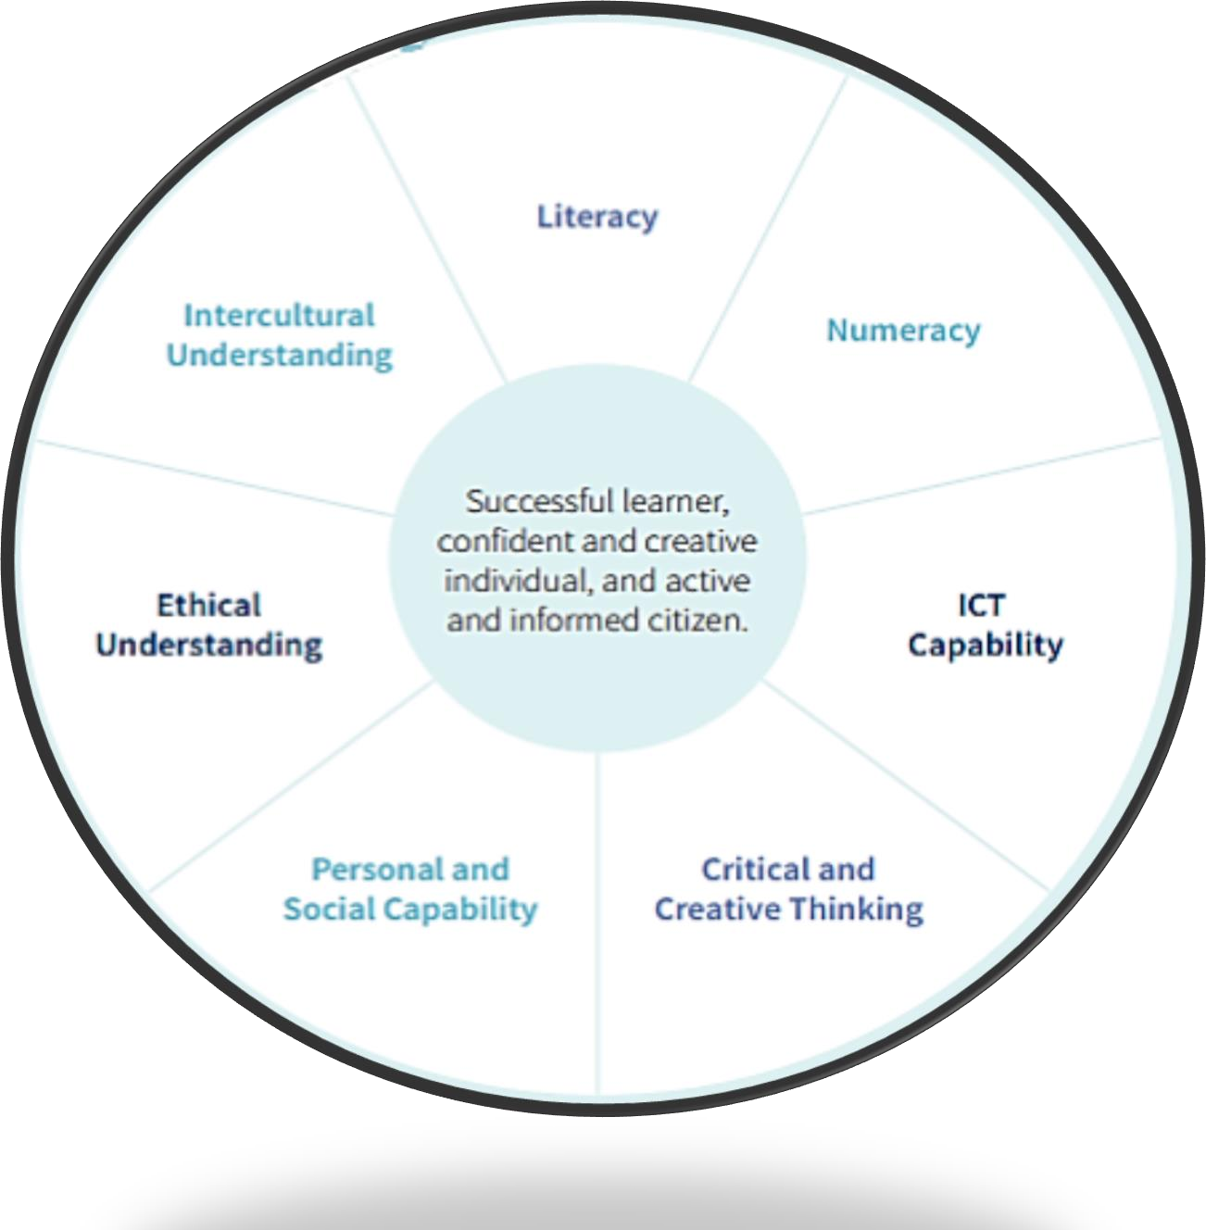
CORE CONCEPTS
INDEGENIOUS
UNDERSTANDING

Slide 10
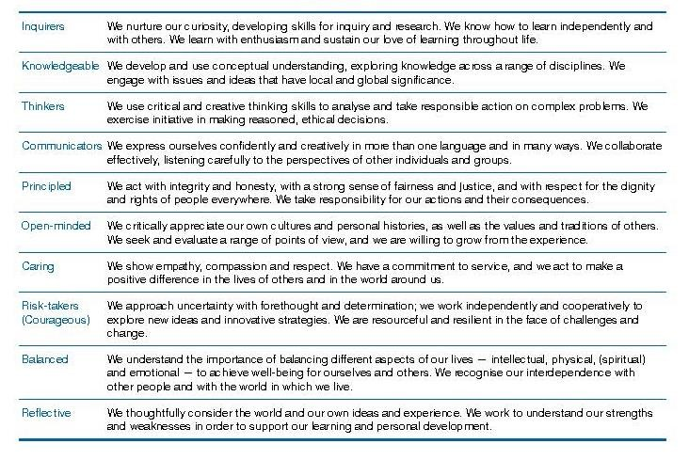
INDICATORS OF A REPORT CARD

Slide 11
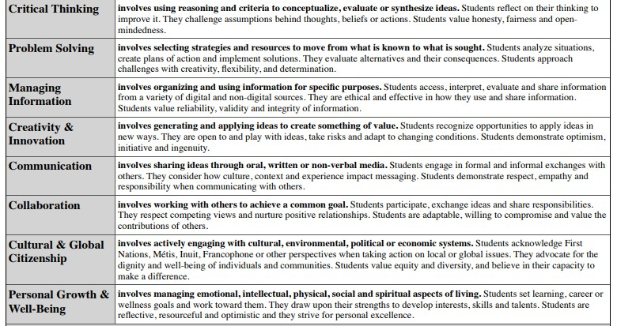
INDICATORS OF A REPORT CARD

Slide 12
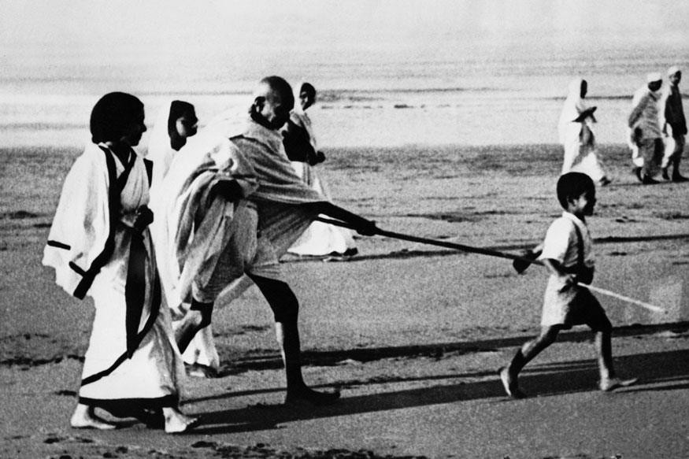
EDUCATION THAT EMPOWERS THE HEAD , HAND AND HEART
A PRESENTATION BY: DR. AMEETA M. WATTAL PRINCIPAL , SPRINGDALES, PUSA
EMAIL: ameetam@gmail.com Phone: 9999198402, 9811452042

